Slide 1
California Wine
1980-2020
By: Grace & Juliana

Slide 2
Our Data
Our Data
What we are looking at?
Where was this found?
Why does this matter?
Features that played biggest role in prediction of Value
Found our data from Kaggle
https://www.kaggle.com/
If you are looking to start Wine Business in California
Notes:
Also add some general statistics about Cali

Slide 3


Variables
Year (1980 - 2020)
Commodity Code (numeric - constant)
Crop Name (grapeswine - constant)
County Code
County
Harvested (Acres)
Yield (Unit/Acre)
Unit (tons)
Production= (Harvested * Yield)
Price (Dollars/unit)
Value (Dollars) = Production * Price

Slide 4

Variables Explanation
01
02
03
04
05
Measured in Units per acres
Measured in Dollars/Unit
Yield
Price
Harvested
Production
Value
Measured in Acres
Harvested * Yield
Production * Price

Slide 5
Names of Counties
Alameda
Amador
Calaveras
Colusa
Contra Costa
El Dorado
Fresno
Glenn
Kern
Kings
Lake
Madera
Marin
Mariposa
Mendocino
Merced
Mono
Monterey
Napa
Nevada
Placer
Riverside
Sacramento
San Benito
San Bernardino
San Diego
San Joaquin
San Luis Obispo
San Mateo
Santa Barbara
Santa Clara
Santa Cruz
Shasta
Solano
Sonoma
Stanislaus
Tehama
Trinity
Tulare
Yolo
Yuba
Our dataset assigned a unique county code to each county
Notes:
Not every county for every year. Some did a lot and some did only like 2

Slide 6

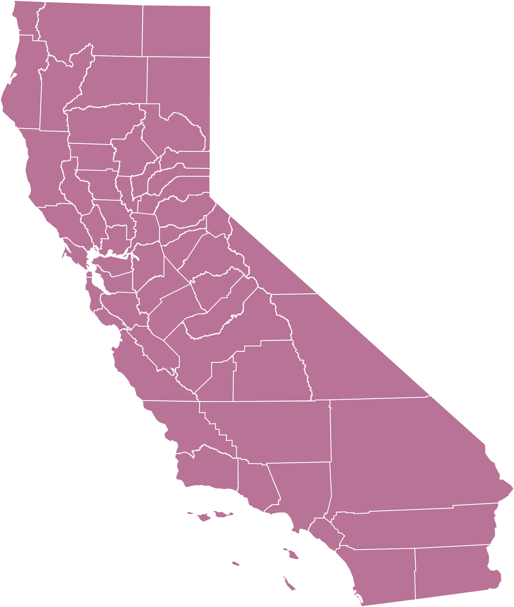


California

Slide 7
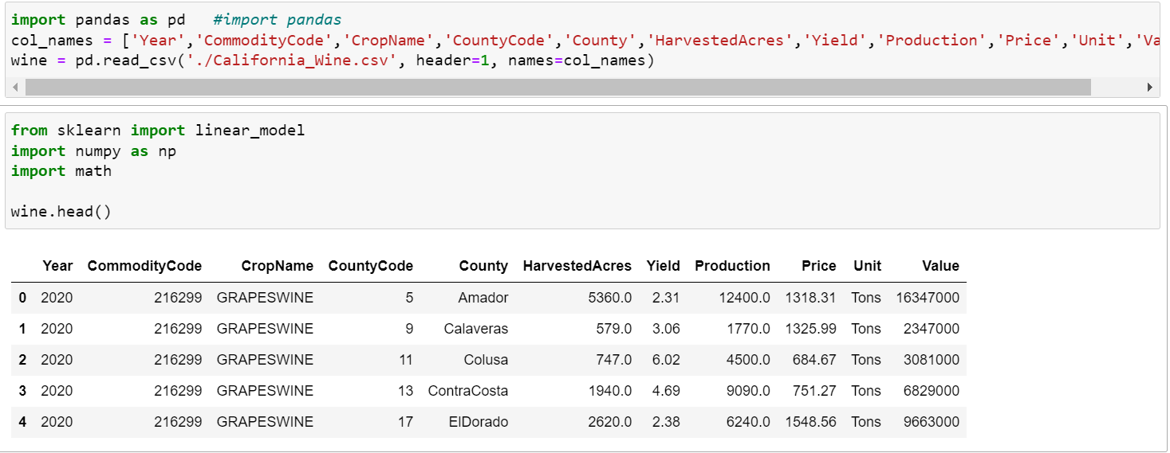
Reading the Dataset

Slide 8

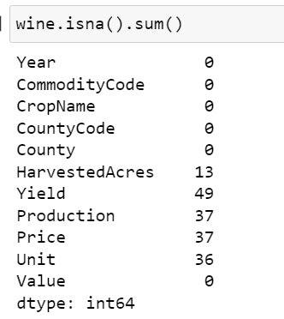
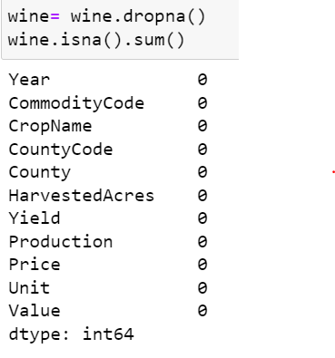
Accounting for n/a Values

Slide 9
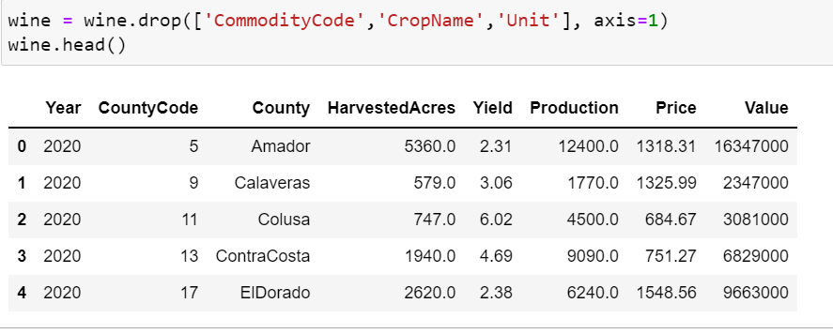
Removing constant variables
New and Improved
Original

Slide 10

Methods used in our Data Analysis
Taste
Smell
Sight
Linear Regression
Decision Tree
RFM
Senses

Slide 11
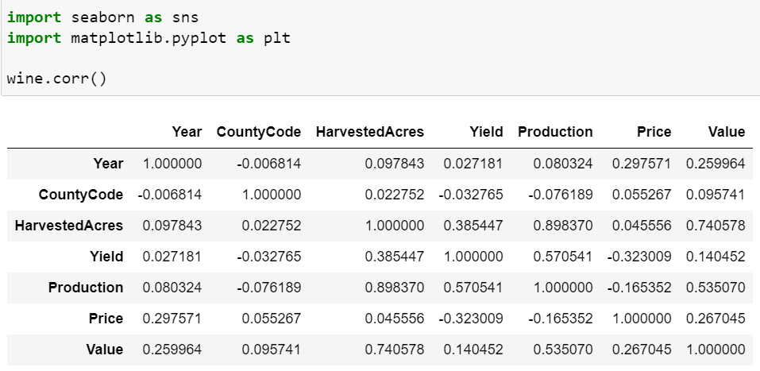

Correlation Matrix

Slide 12
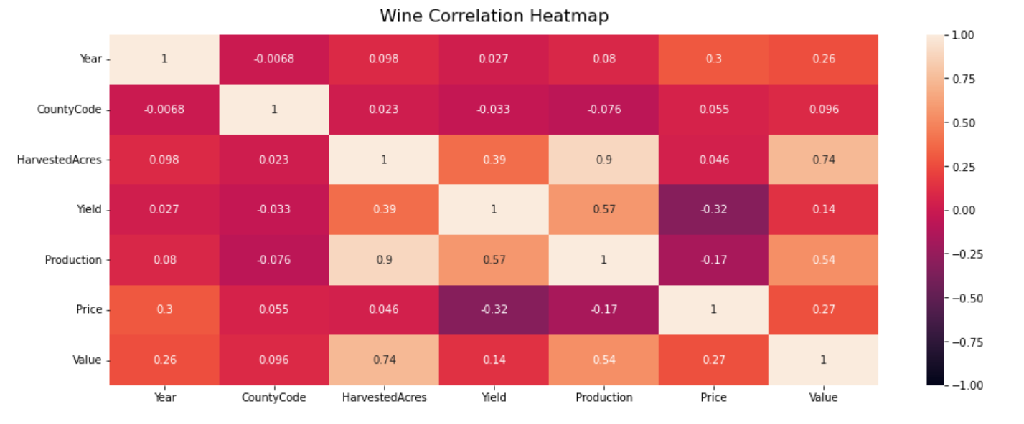
Heat Map

Slide 13

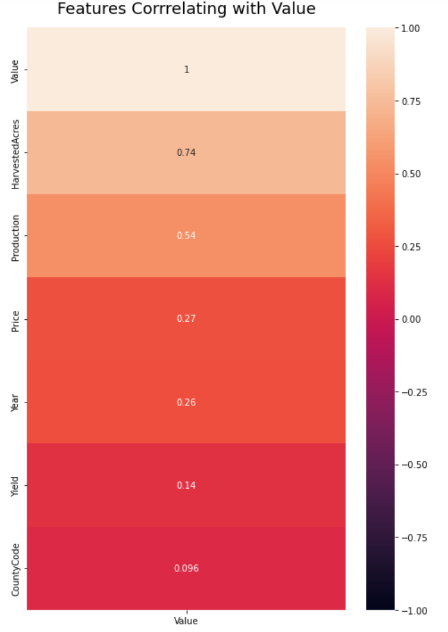

Features Correlating with Value
Features Correlating with Value

Slide 14

Harvested Acres: 0.74
Production: 0.54
Price: 0.27
Year: 0.26

Slide 15
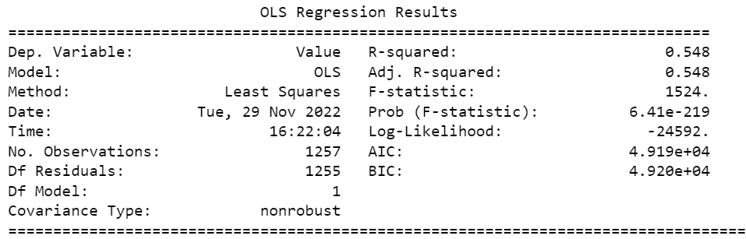
Value ~ Harvested Acres

Slide 16
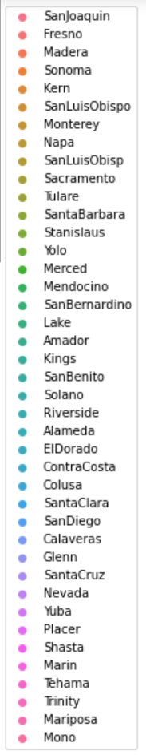
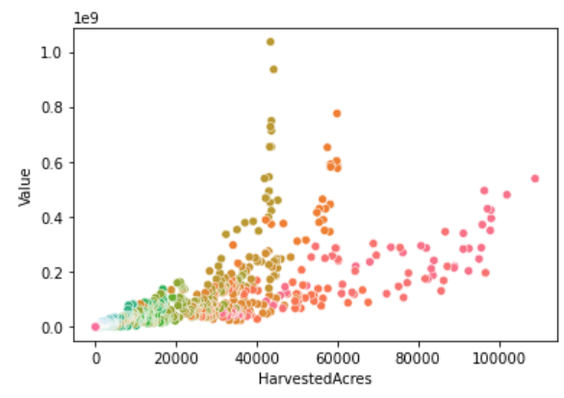
Value ~ Harvested Acres

Slide 17

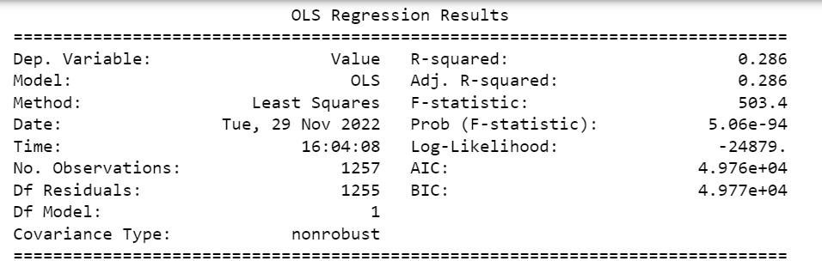
Value ~ Production

Slide 18
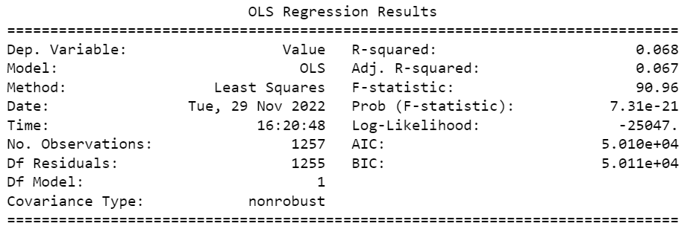
Value ~ Year

Slide 19
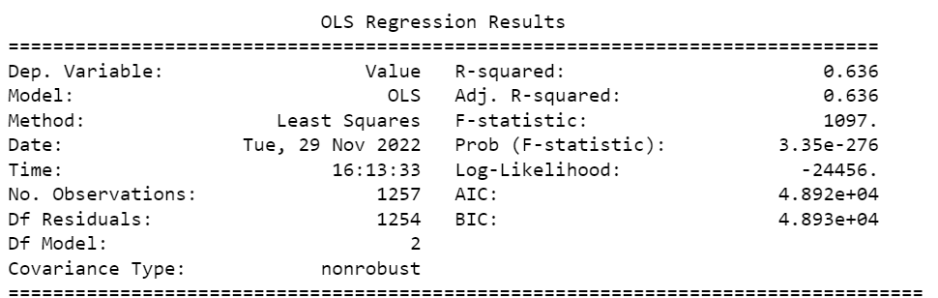
Value ~ Harvested Acres + Production

Slide 20
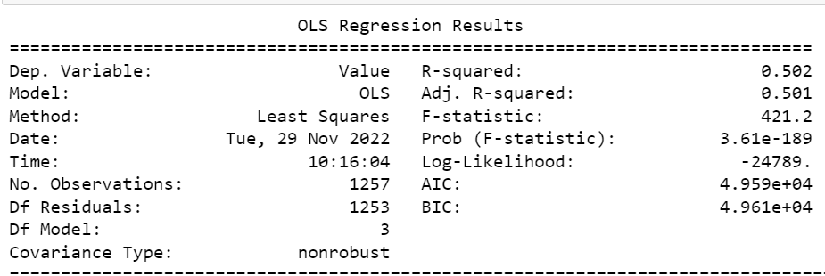
Value ~ Harvested Acres + Production + Price
When we added Year, R-Squared value changed but very slightly

Slide 21
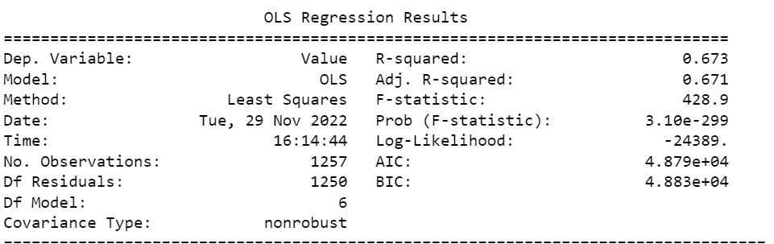
Value ~ Harvested Acres + Production + Price + Year + CountyCode + Yield
When we added Year, R-Squared value changed but very slightly

Slide 22

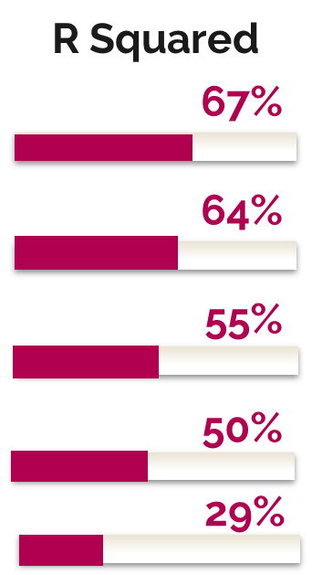
Evaluating Results
Value ~ Harvested Acres + Production + Price + Year + CountyCode + Yield
Value ~ Harvested Acres + Production
Value ~ Harvested Acres + Production + Price
Value ~ Harvested Acres
Value ~ Production

Slide 23
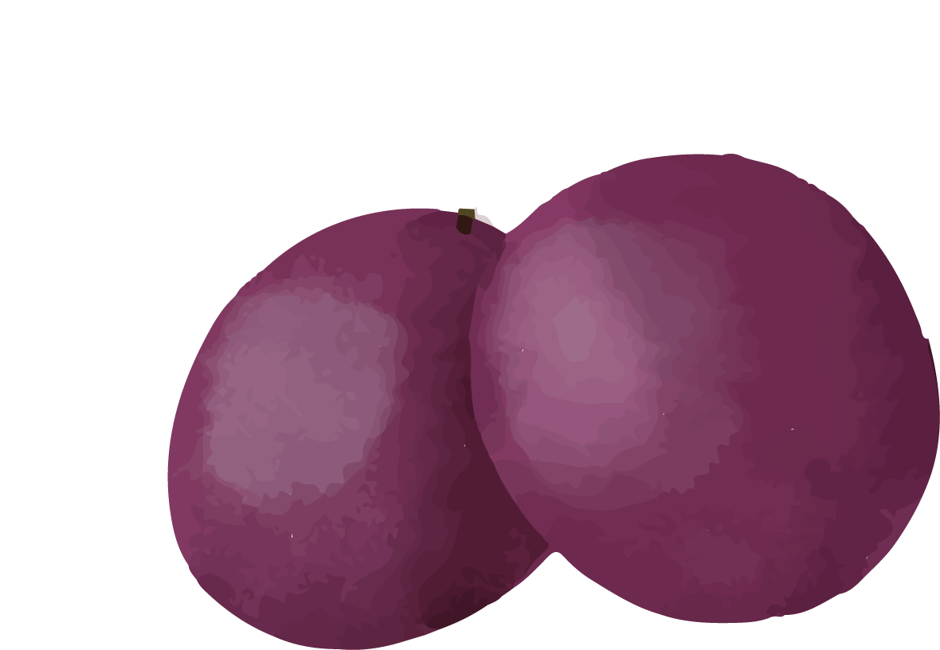
Decision Tree
Classification
Regression
Dependent variable is discrete
Dependent variable can be continuous
Regression

Slide 24
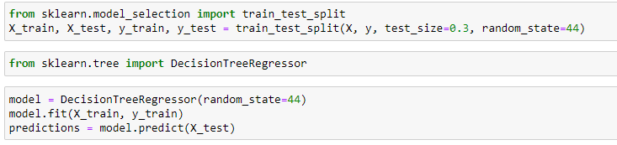
Splitting the Data

Slide 25
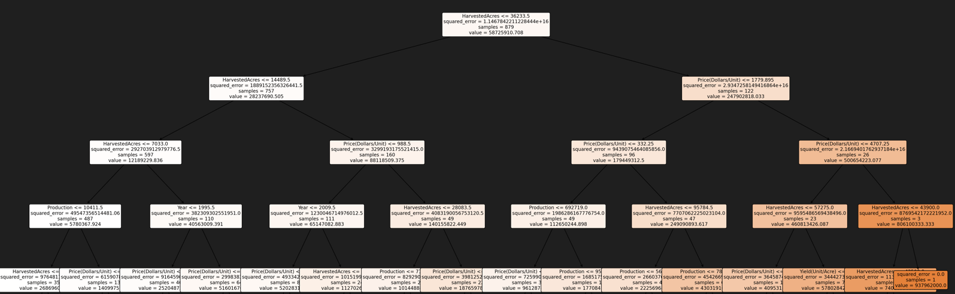

Slide 26

What is RFM
Used in Business Analytics
Categorizes Customers’ Value

Slide 27
RFM
Customer
Purchase History
Recency
Frequency
Monetary

Slide 28
RFM in our Data
01
02
03
04
Recency
Frequency
Monetary
Conclusion
Last time County Produced Wine
Actual Harvested Acres - Mean Value of Harvested Acres
Total Value of each County
Rank Assignments

Slide 29
Calculates
Scores
Ranks
Recency Frequency Monetary
0.15*Recency score + 0.28*Frequency score + 0.57 *Monetary score
Based on a 5 Point Scale
Wine

Slide 30
Calculation baselines
Recency:
Analyze historical (years) in business
Subtracted 2020 from the year in our data. The closer to zero, the higher the rank.
Frequency:
Calculated the mean value of Harvested Acres to use as baseline.
Actual Harvested acres (most achieved over the years)
Monetary:
Sum of Each County overall value through the years
Mean Value

Slide 31
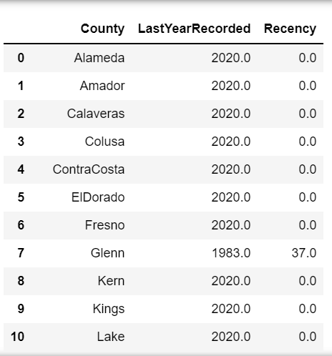
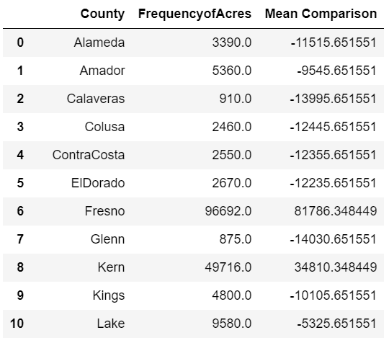
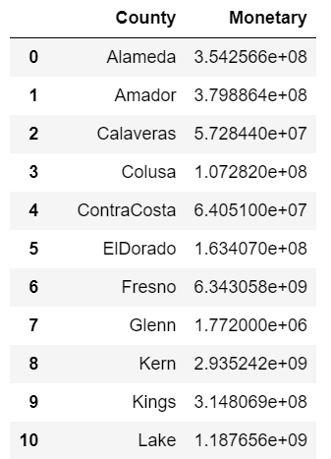

Recency
Frequency
Monetary

Slide 32
County Ranks
Top County
High Value County
RFM Score > 4.0
RFM Score > 4.5
Medium Value County
Low Value County
Lost Value County
RFM Score > 3
RFM Score > 1.6
RFM < 1.6
RFM

Slide 33
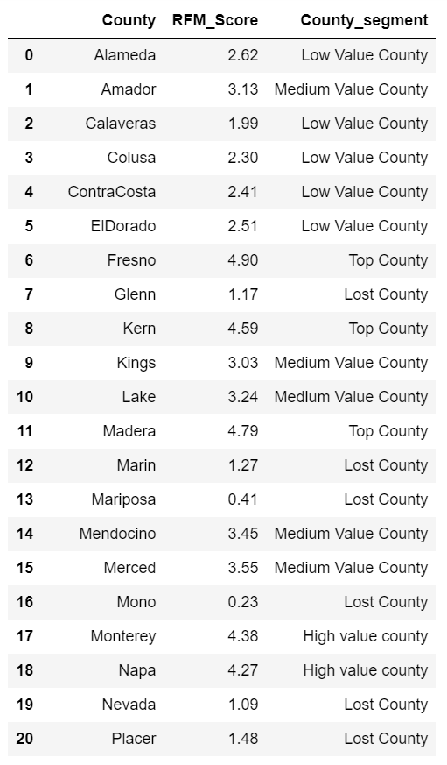

RFM Score and Title Rank

Slide 34
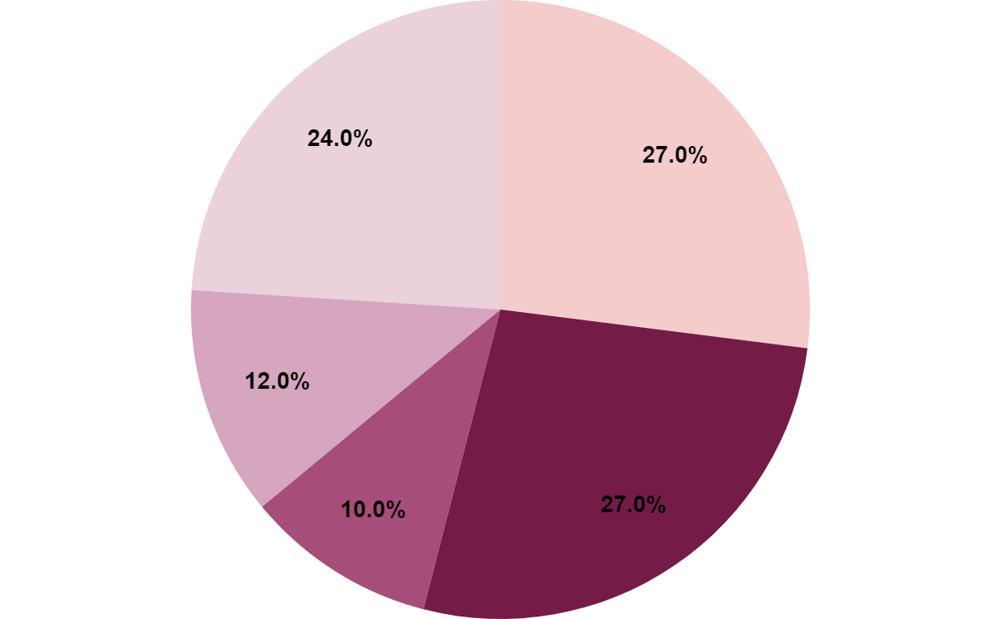
RFM Pie Chart
24% Lost Value Counties
27% Low Value County
27% Medium Value County
12% Top Value Counties
10% High Value Counties

Slide 35
Top Performing County
San Joaquin

Slide 36


Final Thoughts
Linear Regression
RFM
Price and Yield do not show strong correlation to Value.
Some counties could have less yield but high price.
Useful in determining top performing counties
Decision Tree
Regression Decision Tree showed Harvested Acres to be a big contributor to Value
Conclusions

Slide 37
Thank You

Slide 38
Works Cited
How to calculate the RFM score for each customer (omniconvert.com)
Python | Decision Tree Regression using sklearn - GeeksforGeeks
RFM Analysis Analysis Using Python - GeeksforGeeks
Kaggle: Your Home for Data Science
10 Must-Know Facts About California Wines | WineCountry.com
Regression Tree in Python Using Scikit-learn (Code Your Decision Tree Part #1)
sklearn.tree.plot_tree — scikit-learn 1.1.3 documentation
Understanding the decision tree structure — scikit-learn 1.1.3 documentation
Sources

Slide 39
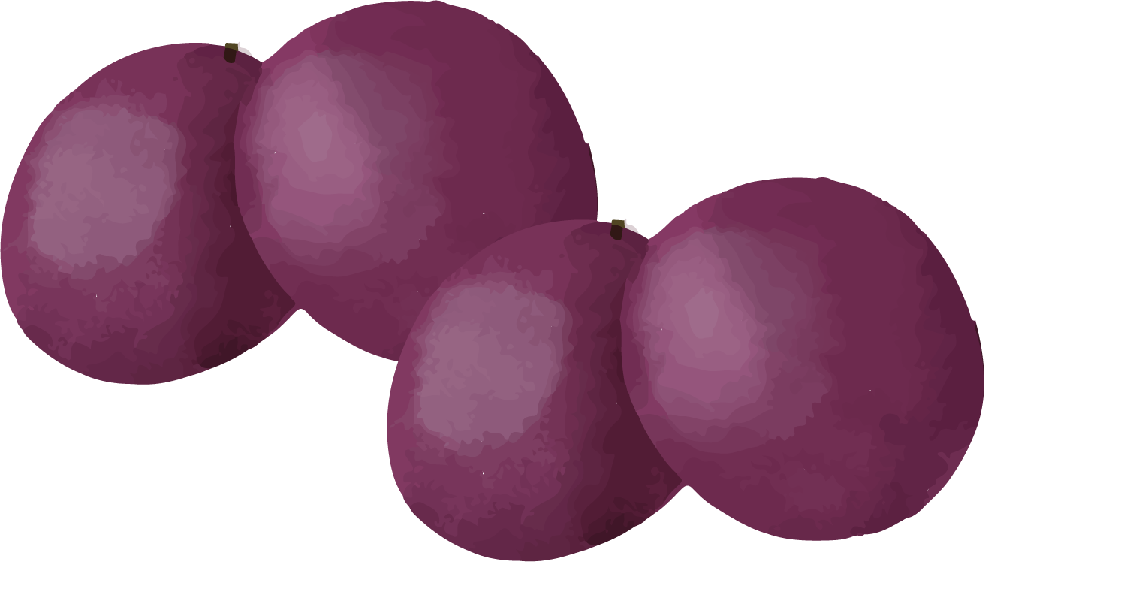
Thanks!

Slide 40


